Slide 1
Boston Housing Prices
By Thomas Simon

Slide 2
Agenda
Problem Statement
Causes of Median Home Value Decrease
Home Value Decreases (Continued)
Causes of Median Home Value Increases
Recommendation

Slide 3
Problem Statement
How can crime rate, non-retail businesses per town, and the avg number of rooms per dwelling increase the median value of homes by at least 5%, within a year? In general, what are the key factors that are driving the median value of owner-occupied homes?

Slide 4
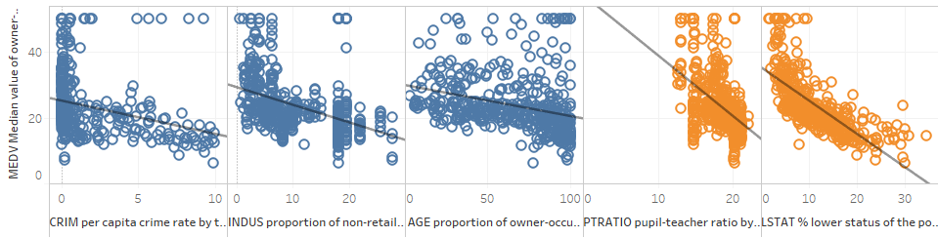
There are a list of factors that affect the decrease in the median home value, but most notably are the Pupil-teacher ratio by town and the Lower Status of the Population.
Key Insights
Pupil-teacher ratio by town and Lower Status of Population both seem to have more noticeable effects on the Median value of owner-occupied homes; this shows that as Pupil-teacher ratio and Lower Status increase, the value of the home decreases substantially. To mitigate drops in home value, we should look for ways to decrease the pupil-teacher ratio so students can get a better learning experience, which in turn, will lead to higher home values.

Slide 5
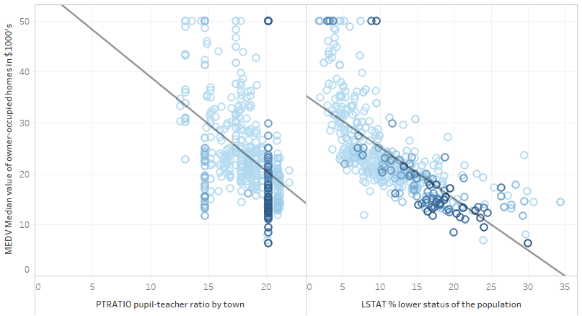

Crime Rate is also a result of an increase in the Pupil-teacher ratio by town and the Lower Status of the Population.
Key Insights
Drilling down further into the pupil teacher ratio and lower status numbers, we can see that they both seem to have a high correlation with a larger crime rate as well. This means that to not increase the median home values, but to decrease the crime rate, we should look to focus on decreasing the lower status of the pop. And pupil-teacher ratio.

Slide 6
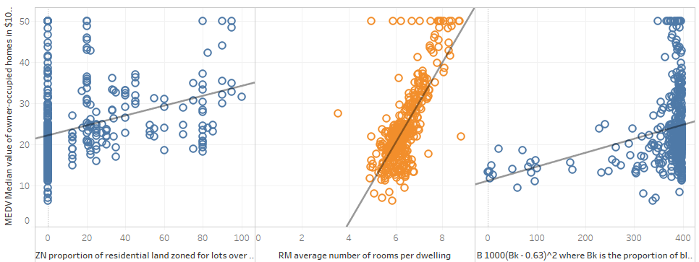
There are 3 notable variables that increase in proportion to the median value of owner-occupied homes.
Key Insights
The average number of rooms per dwelling has the most significant effect on an increase in the median home value. Thus, we should look for ways to increase the number of rooms in mid-to-low median home value areas to give the quickest boost their home prices.

Slide 7

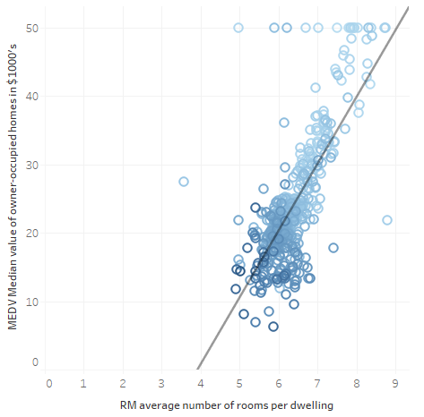
Recommendation: Investing in building out more rooms in lower-status parts of the population in addition to focusing on reducing the pupil-teacher ratio enables a promising trajectory toward increased home values.
Key Insights
Looking further into the average number of rooms per dwelling against the median value of owner-occupied homes, we can see that the lower status of the population tends to have fewer rooms per dwelling, and thus brings down the home value for them. My recommendation for the Boston Housing Authority is to invest in more rooms per dwelling in lower status communities to increase their home values.

